Slide 1
Cloud Strategy and Infrastructure Deployment for Airbnb Using AWS Tier

Slide 2
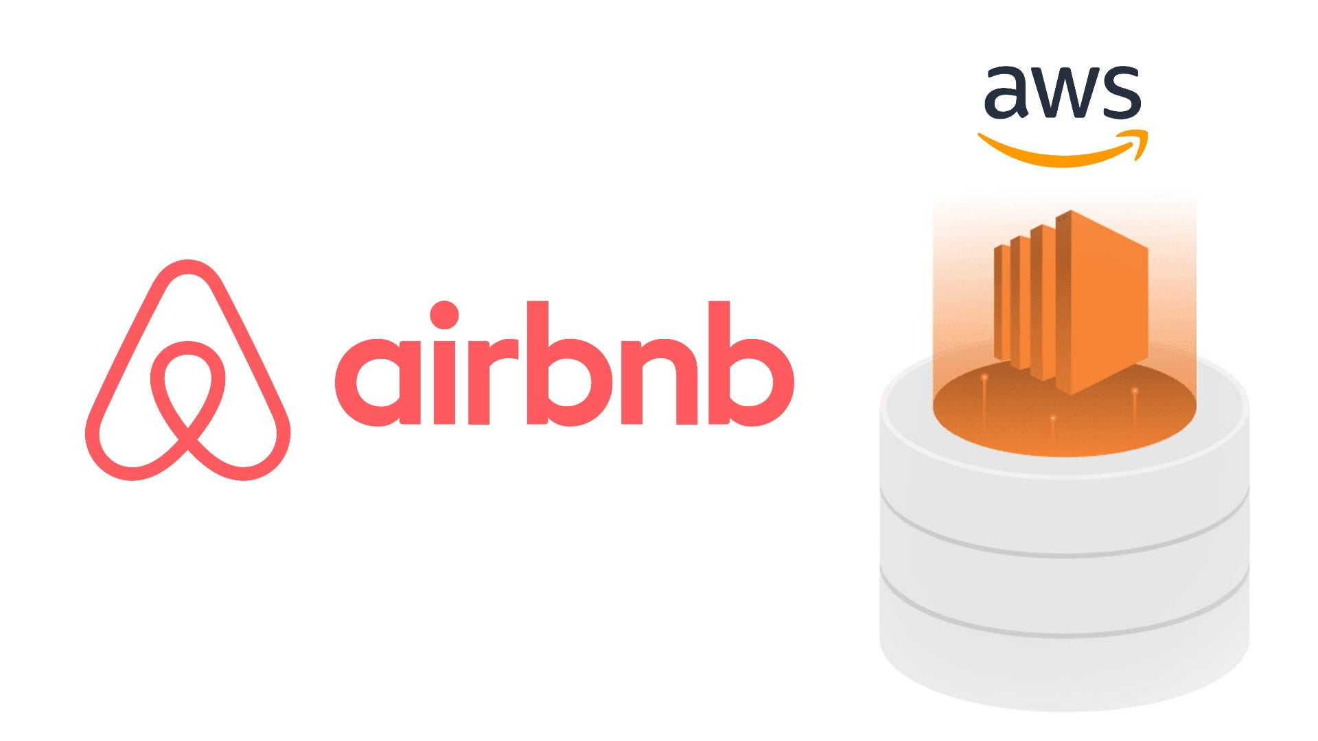
Group Members
Alen Joseph 20034303
Kanak Kaushik 20018171
Mohammed Hisham 20034931
Preethi Jacob Vithayathil 20018276

Slide 3
Introduction
Objective
We aimed to enhance Airbnb's IT infrastructure using AWS Free Tier services.
Importance
We addressed key challenges including scalability, performance, and cost management.
Implementing a serverless architecture helped us achieve better efficiency and adaptability.
Overview
We utilized AWS Lambda for serverless computing, API Gateway for efficient API management, and DynamoDB for scalable data storage.
Our goal was to achieve automatic scaling, significant cost savings, and improved overall performance for Airbnb's operations.

Slide 4
Background of Airbnb
Founded in 2008, Airbnb operates in the online marketplace and hospitality industry.
The platform connects hosts with guests worldwide, boasting millions of listings across over 190 countries.
As Airbnb continues to grow, it faces challenges in maintaining a scalable and efficient IT infrastructure.

Slide 5
Current IT Setup
Servers: Dedicated servers for web applications and services.
Databases: Relational databases for user data, listings, and transactions.
Storage: Traditional storage systems for static assets.
Networking: Includes routers, switches, and firewalls for secure data transmission.
Challenges: Scalability, high costs, performance bottlenecks, and maintenance overhead.

Slide 6
Cloud Strategy Overview
Objective: Enhance scalability, performance, and cost-efficiency.
Key Components:
AWS Lambda: Serverless computing for automatic scaling.
API Gateway: Efficient management of HTTP requests.
DynamoDB: Scalable NoSQL database for data storage.
CloudWatch: Monitoring and logging for proactive issue resolution.
Benefits:
Scalability: Automatic scaling to handle traffic variations.
Cost-Efficiency: Pay-as-you-go model reduces costs.
Performance: High availability and low-latency services.
Security: Robust security features and compliance with industry standards.

Slide 7
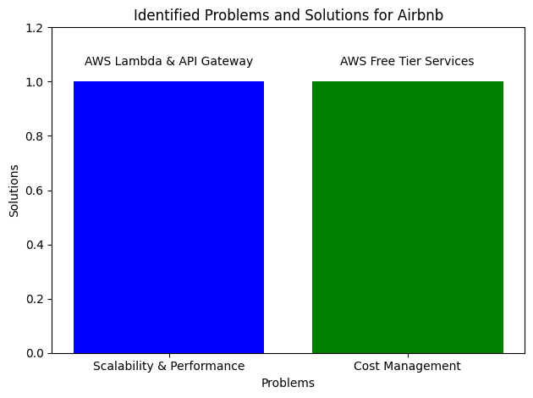
Identified Problems

Slide 8
Solutions Implemented
Scalability and Performance:
AWS Lambda:
Implemented serverless computing for automatic scaling.
Handles varying traffic loads efficiently.
API Gateway:
Manages HTTP requests and routes them to Lambda functions.
Ensures reliable communication between users and backend services.
Cost Management:
AWS Free Tier Services:
Utilized free tier limits for Lambda, API Gateway, and DynamoDB.
Reduced operational costs with a pay-as-you-go model.

Slide 9
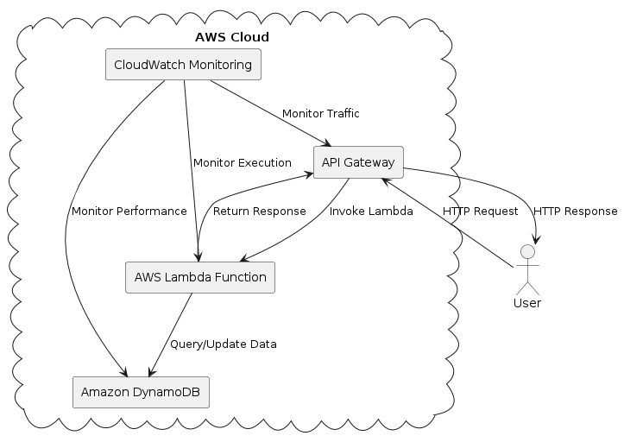
Architecture of the Solution Implemented

Slide 10
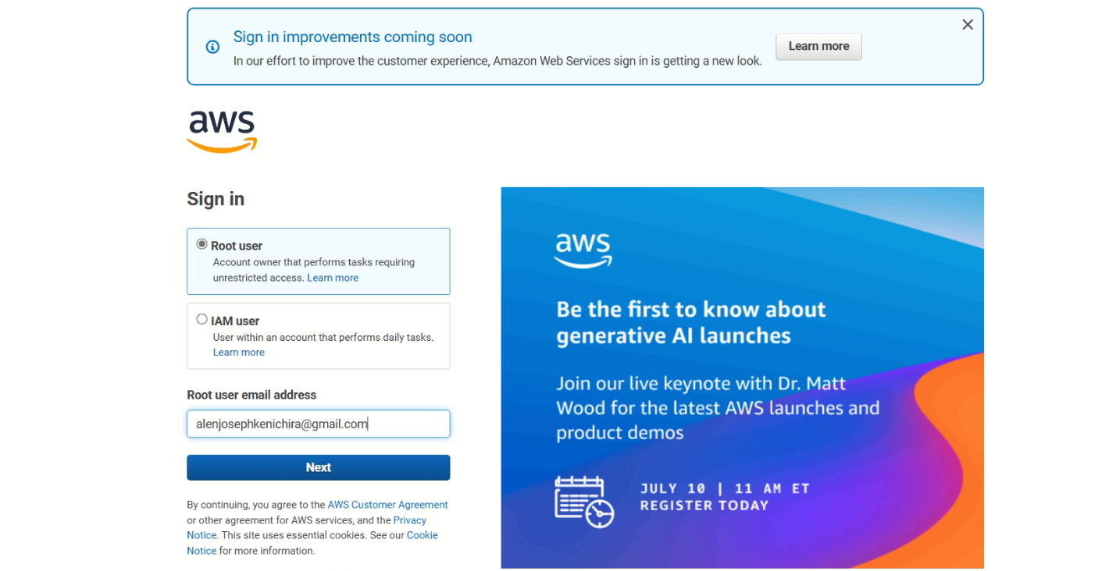
Setting Up AWS Account
Steps
We signed up for AWS Free Tier account
We configured IAM roles and permissions
We set up billing alerts

Slide 11
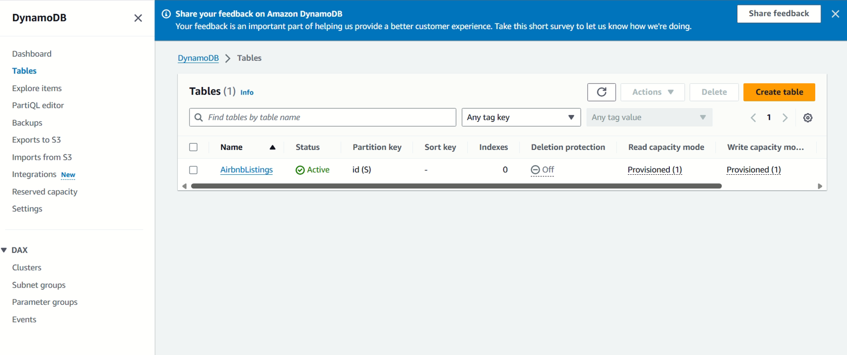
Creating and Configuring DynamoDB Table
Table Creation | Configuration
Table name: AirbnbListings | Provisioned capacity
Primary key: id (string) | Indexing for efficient queries

Slide 12
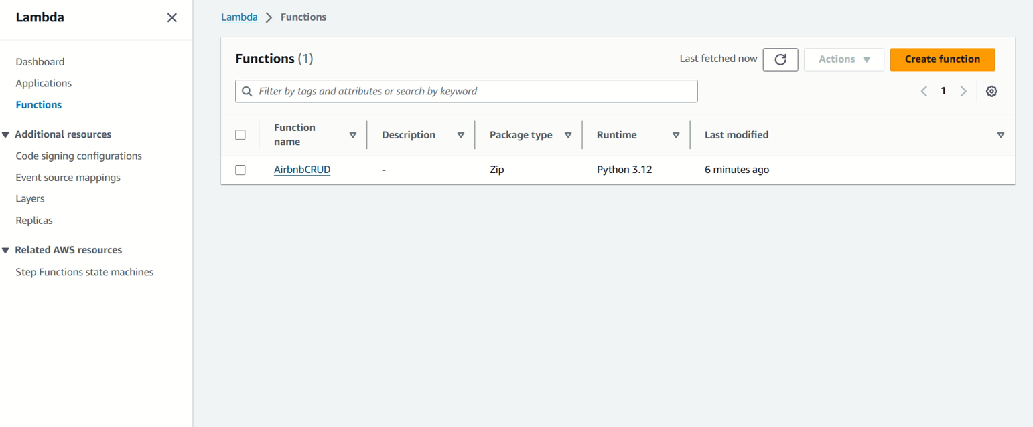
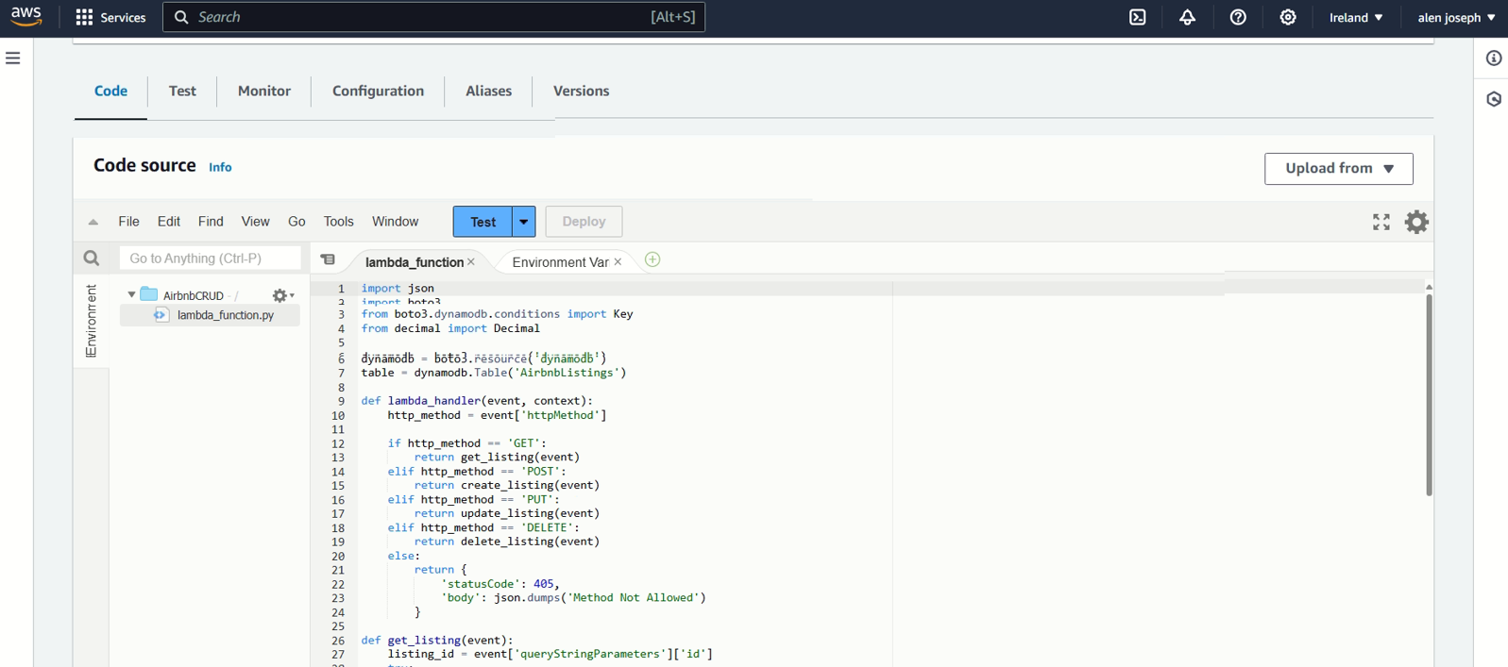
Creating Lambda Function
Steps | Functionality
We created a function named AirbnbCRUD | Handles CRUD operations for AirbnbListings table
Runtime: Python 3.x
We configured IAM role with necessary permissions

Slide 13
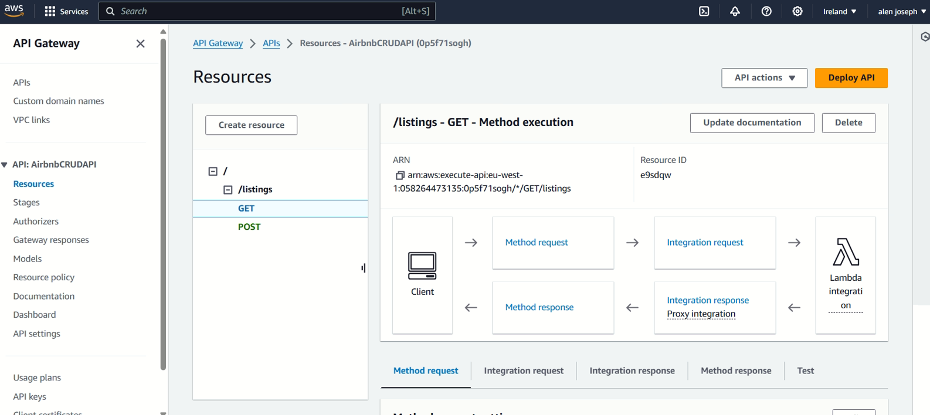
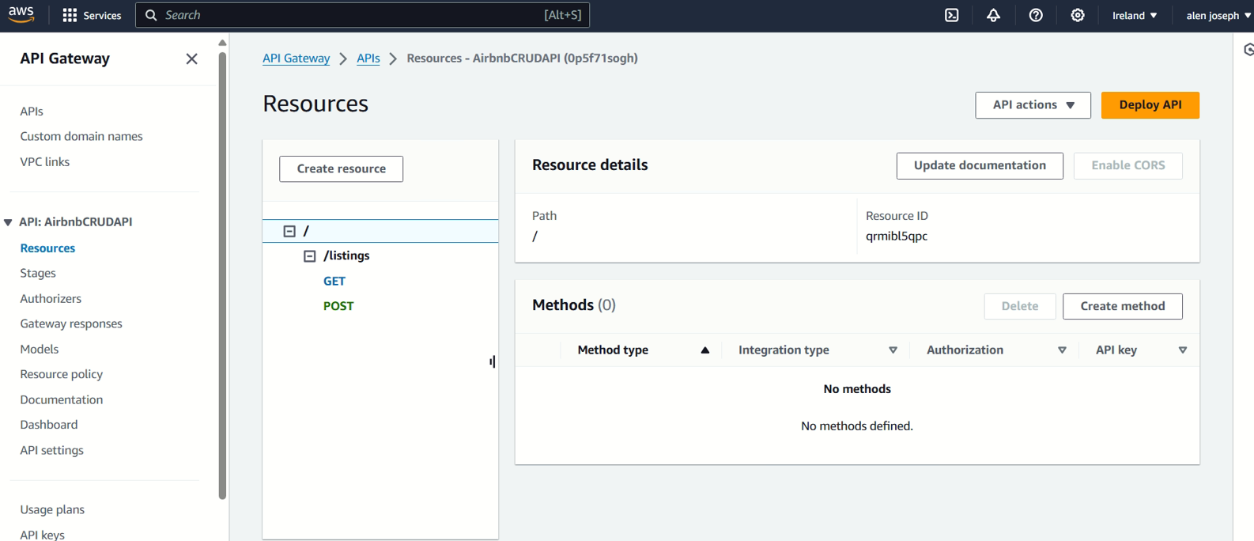
Setting Up API Gateway
Steps | Deployment
We created REST API named AirbnbCRUDAPI | Deployed to stage: prod
We defined resource: listings
Methods: GET, POST.
We integrated with Lambda functions

Slide 14
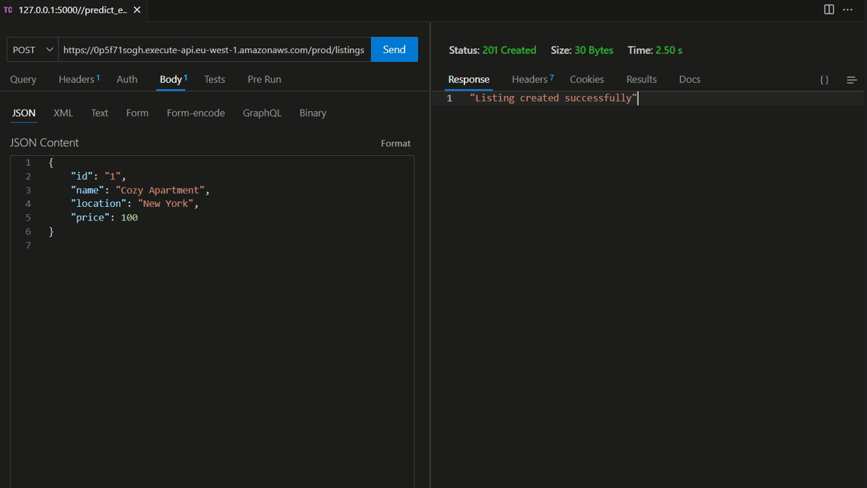
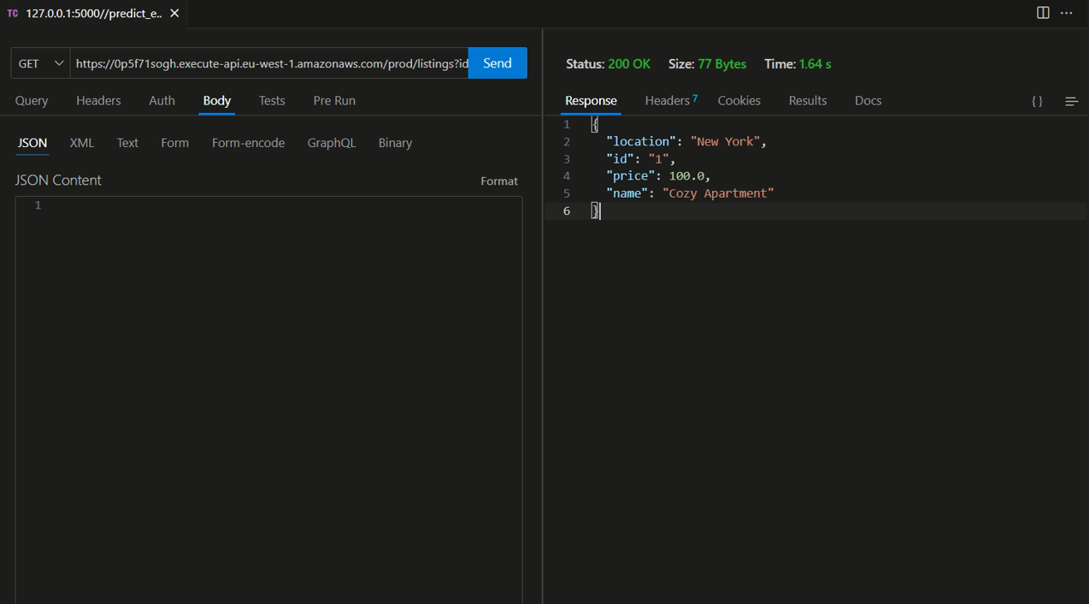
Testing the API
Tools Used | Methods | Results
Postman, curl | POST: Add a new listing | Successful addition and retrieval of listings
 | GET: Retrieve a listing

Slide 15
Costs and Budget
Service | Free Tier Limit | Expected Costs
AWS Lambda | 1 million requests, 400,000 GB-seconds | Free within limits, cost-effective scaling beyond
API Gateway | 1 million API calls | Free within limits, minimal cost beyond
DynamoDB | 25 GB storage, 25 read/write capacity units | Free within limits, scalable costs beyond
CloudWatch | Basic monitoring free | Costs for advanced features, if needed

Slide 16
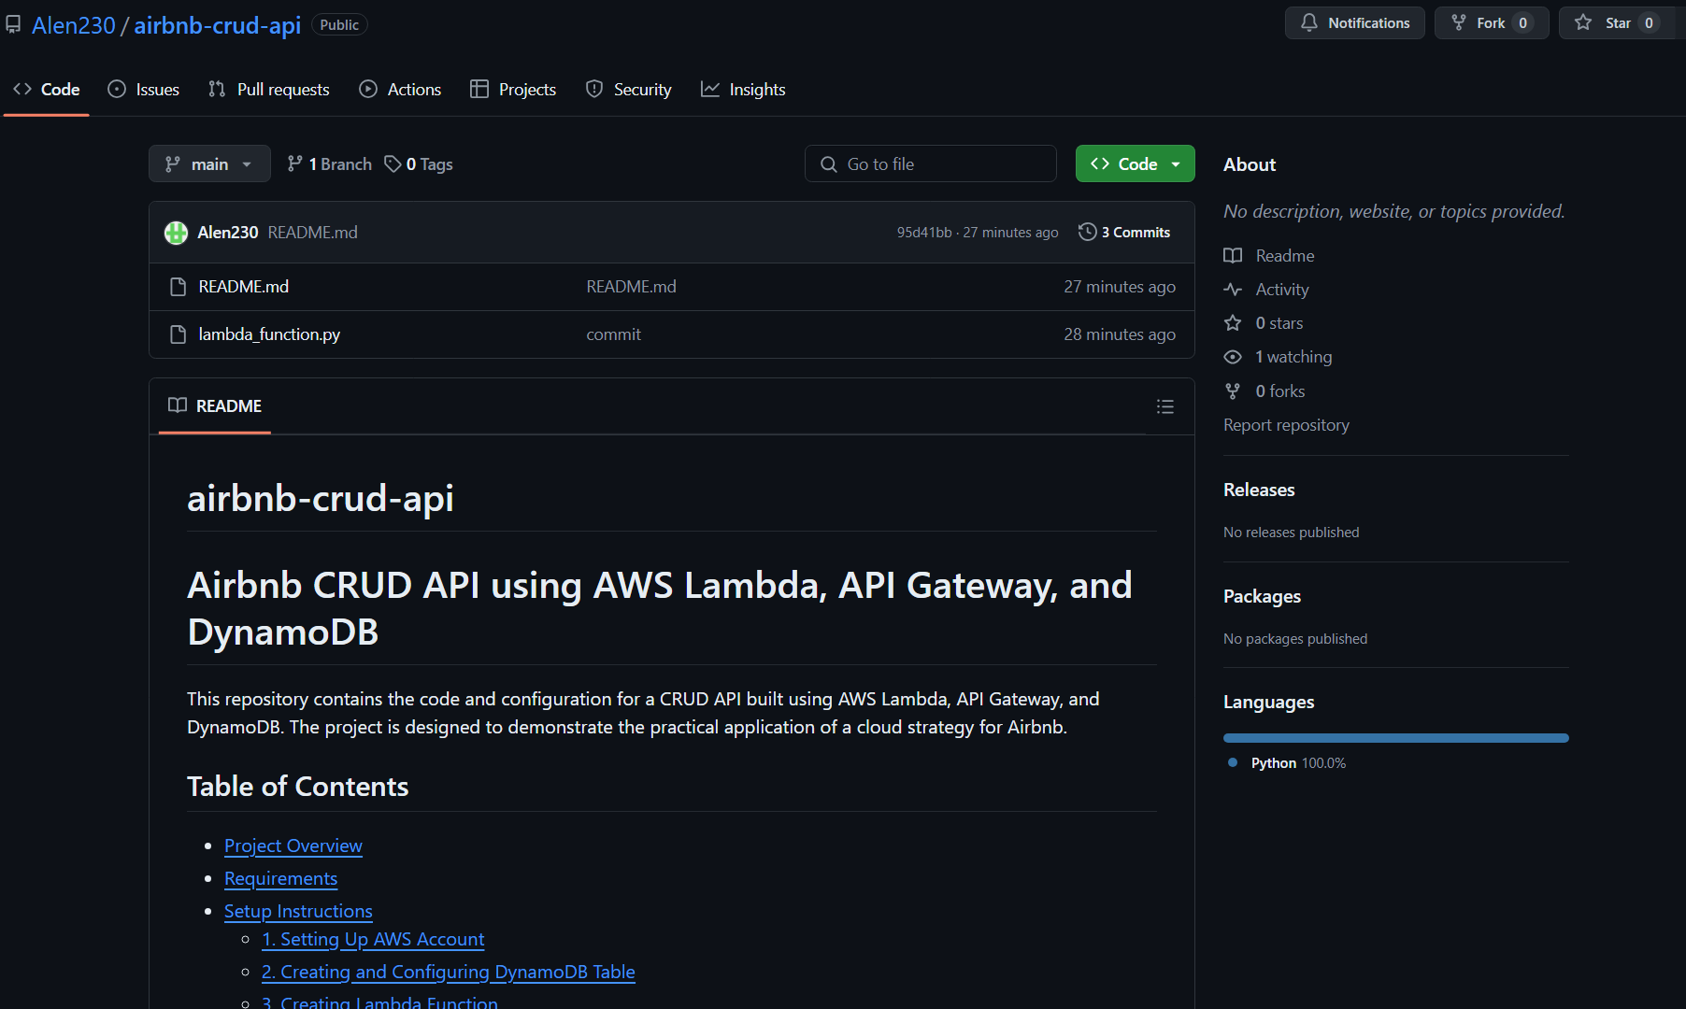
Use of GitHub
Wе usеd GitHub for vеrsion control and projеct managеmеnt. Our rеpository, accеssiblе at https://github.com/Alеn230/airbnb-crud-api/trее/main, contains all rеlеvant filеs, including thе lambda_function.py and README.md. This sеtup еnsurеs propеr documеntation, vеrsion history, and collaborativе dеvеlopmеnt, facilitating еfficiеnt projеct managеmеnt and transparеncy.

Slide 17
Conclusion
Enhanced Scalability and Performance: We achieved automatic scaling and high performance using AWS Lambda and API Gateway, addressing Airbnb's growing user demands.
Cost-Efficiency: By leveraging AWS Free Tier services, we significantly reduced operational costs while maintaining high availability and reliability.
Improved Data Management: Amazon DynamoDB provided a scalable and secure solution for storing and managing dynamic datasets efficiently.
Proactive Monitoring: Amazon CloudWatch enabled real-time monitoring and logging, ensuring prompt issue resolution and maintaining optimal system performance.

Slide 18
Thank You

